Slide 1
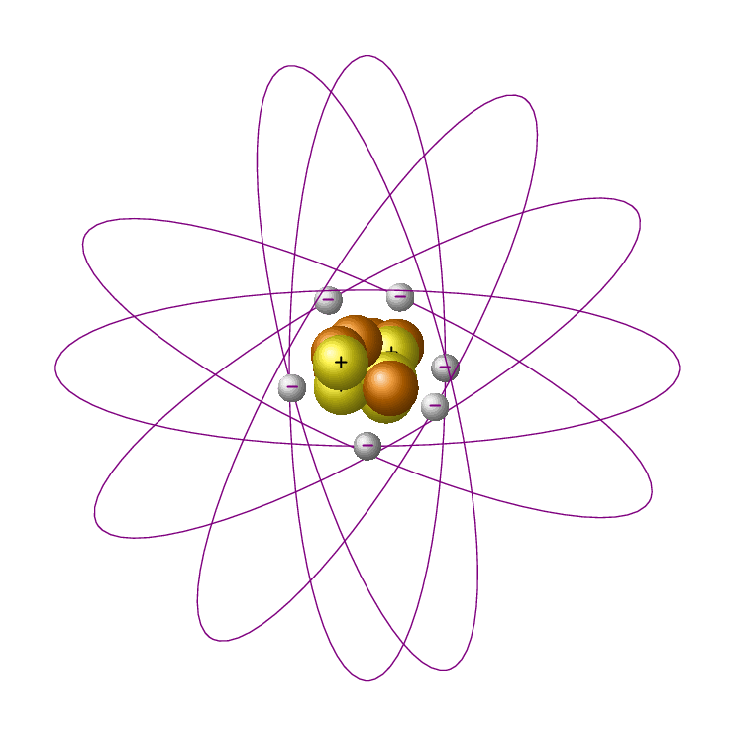
The Atom
Year 10 PreATAR Science

Slide 2
Learning Intentions
Chemical sciences
The atomic structure and properties of elements are used to organise them in the Periodic Table

Slide 3
Success Criteria
Identify the number of protons, neutrons and electrons in an atom
Use a periodic table to determine how many protons, neutrons and electrons are in atoms
Write atomic number and mass number for atoms

Slide 4
Key words
nucleus
protons, neutrons, electrons
energy levels
atomic number
mass number
relative atomic mass (“atomic weight”)

Slide 5
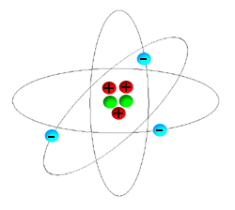
Atomic structure
Nucleus contains protons and neutrons
surrounded by a “cloud” of electrons.
Electrons are found in distinct energy levels.
positive
neutral
(no charge)
negative

Slide 6
Protons and neutrons are almost identical in size and mass.
The nucleus contains almost all of the mass of the atom, despite taking up less than 10⁻¹² of its volume.

Slide 7
Most of the atom is empty space, through which negatively charged electrons orbit at high speed.
Electrons are much smaller and lighter than protons and neutrons, and so contribute almost no mass to the atom.

Slide 8


Slide 9
Atomic number
The atomic number of any atom is the number of protons in the nucleus.
The atomic number defines the element,
ie all hydrogen atoms have 1 proton,
all helium atoms have 2 protons
and so on…

Slide 10
Mass number
The relative mass of a proton or neutron is 1
atomic mass unit
The mass number of a particular atom is the number of protons plus neutrons in that atom.

Slide 11
mass number
A
X
element symbol
Z
atomic number

Slide 12
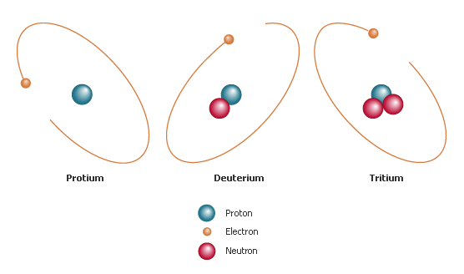
Isotopes
Atoms of the same element have the same number of protons, but may have a different number of neutrons.

Slide 13
These different forms of the same element are called isotopes, and are distinguished by their different mass numbers.
Isotopes share chemical properties, but have different physical properties.

Slide 14
Relative atomic mass
“atomic weight”
The average mass number of atoms of that element.
Determined by isotopic composition – ie proportion of each isotope.

Slide 15
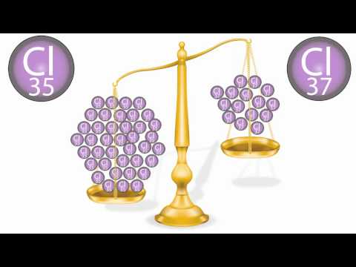

Slide 16
Success Criteria
Identify the number of protons, neutrons and electrons in an atom
Use a periodic table to determine how many protons, neutrons and electrons are in atoms
Write atomic number and mass number for atoms

